Slide 1
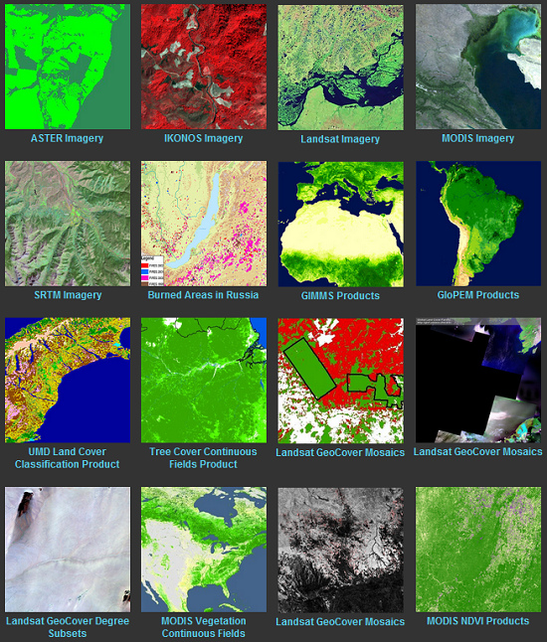
Tutorials on Data Management
Lesson 1: Introduction to Data Management
Why Data Management?
CC image by University of Maryland Press Releases on Flickr

Slide 2
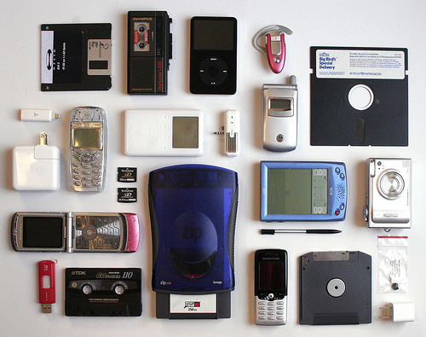
Lesson Topics
The data world around us
Importance of data management
The data lifecycle
The case for data management
CC image by interpunct on Flickr

Slide 3
Learning Objectives
After completing this lesson, the participant will be able to:
Give two general examples of why increasing amounts of data is a concern
Explain, using two examples, how lack of data management makes an impact
Define the research data lifecycle
Give one example of how well-managed data can result in new scientific conclusions

Slide 4
Data Realities…

Slide 5
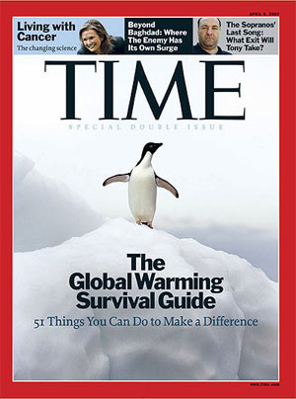








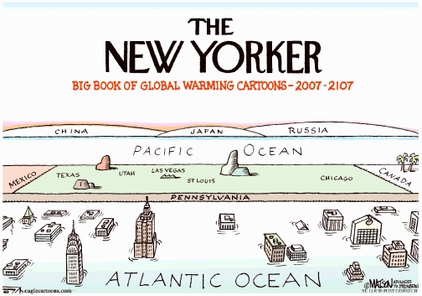
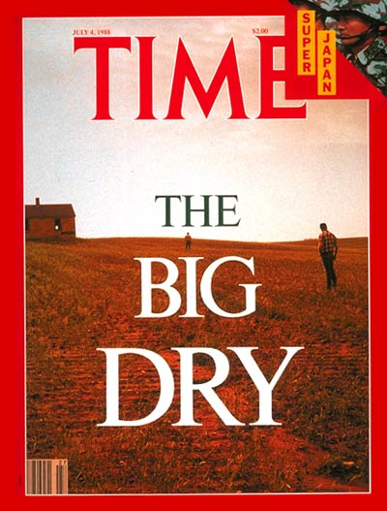


Images collected by DataOne.org
Notes:
The world today is filled with science news, from climate change to hurricanes – and it all affects the people inhabiting the earth.

Slide 6
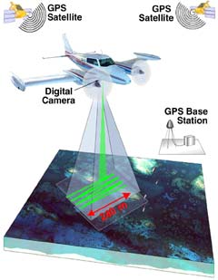
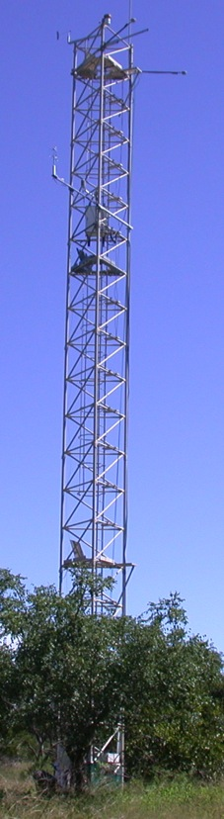

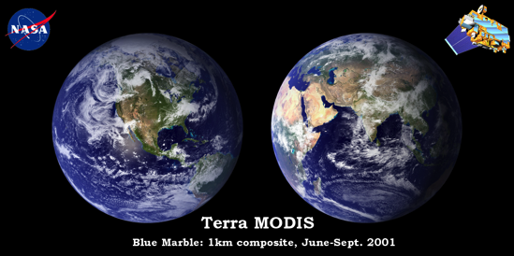
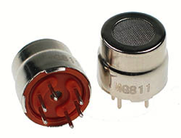
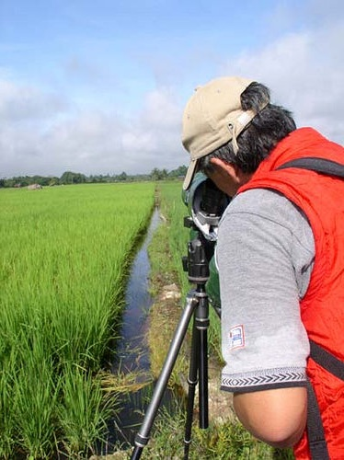
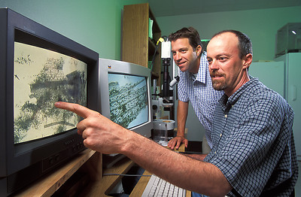
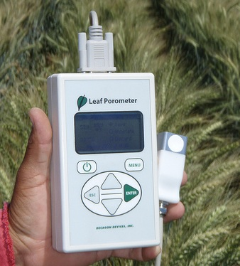
Data Deluge
Data are collected from sensors, sensor networks, remote sensing, observations, and more - this calls for increased attention to data management and stewardship
Photo courtesy of http://modis.gsfc.nasa.gov/
Photo courtesy of
http://www.futurlec.com
CC image by tajai on Flickr
Photo courtesy of www.carboafrica.net
CC image by CIMMYT on Flickr
Image collected by Viv Hutchinson
Notes:
“Big data” is a term increasingly heard in both main stream media and academia. Data are being generated in massive quantities daily. Improvements in technology enable higher precision and coverage in data acquisition and make high capacity systems store and migrate more data –increasing the importance of managing, integrating, and re-using data.

Slide 7
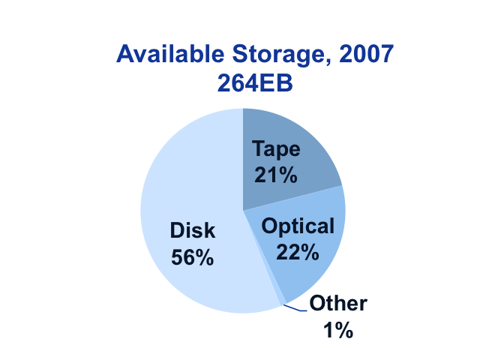
The World of Data Around Us
Transient information or unfilled demand for storage
Information
Petabytes Worldwide
Available Storage
Source: John Gantz, IDC Corporation: The Expanding Digital Universe
Notes:
6
The amount of available storage is not keeping up with the amount of data flooding in daily. How do we decide what data we keep?
Source: John Gantz, IDC Corporation. 2007. The Expanding Digital Universe, an IDC White Paper sponsored by EMC.

Slide 8
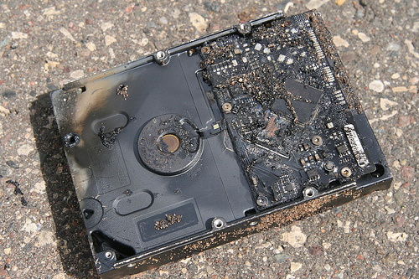
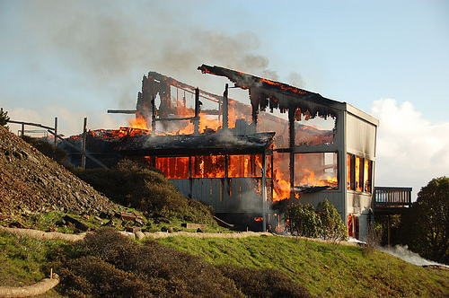
The World of Data Around Us: Data Loss
Natural disaster
Facilities infrastructure failure
Storage failure
Server hardware/software failure
Application software failure
External dependencies (e.g. PKI failure)
Format obsolescence
Legal encumbrance
Human error
Malicious attack by human or automated agents
Loss of staffing competencies
Loss of institutional commitment
Loss of financial stability
Changes in user expectations and requirements
CC image by Sharyn Morrow on Flickr
CC image by momboleum on Flickr
Notes:
In addition to increasing volumes of data and concerns about storage, loss of data is also a concern that can be mitigated by proper data management. These are some examples of how data loss may occur.

Slide 9
Poor Data Management Real World Examples

Slide 10



Poor Data Management Affects Everyone
“MEDICARE PAYMENT ERRORS NEAR $20B” (CNN) December 2004
Miscoding and billing errors from doctors and hospitals totaled $20 billion in FY 2003 (9.3% error rate). The error rate measured claims that were paid despite being medically unnecessary, inadequately documented, or improperly coded. This error rate actually was an improvement over the previous fiscal year (9.8% error rate).
“AUDIT: JUSTICE STATS ON ANTI-TERROR CASES FLAWED” (AP) February 2007
The Justice Department Inspector General found only two sets of data out of 26 concerning terrorism attacks were accurate. The Justice Department uses these statistics to argue for their budget. The Inspector General said the data “appear to be the result of decentralized and haphazard methods of collections … and do not appear to be intentional.”
“SOCIAL SECURITY DATA CAN TURN PEOPLE INTO THE LIVING DEAD” (NPR) August 2016
In 2011, an audit found that about 1,000 people a month in the U.S. were marked deceased when they were very much alive. Rona Lawson, who works in the Office of the Inspector General at the Social Security Administration, says that number has gone down. It's now around 500 people a month. Lawson says 90 percent of the time, the cascade of misinformation starts with an input error by Social Security staff — a regular mistake on a regular office day that just happens to kill a person off, at least on paper.
Slide courtesy of BLM
Notes:
Consider some of the data management issues that made headlines, affecting agencies and organizations. Data quality is not limited to any one organization. These examples show costs (in terms of money lost) due to a lack of data quality control.
Sources: 1) https://web.archive.org/web/20041217035516/http://www.cnn.com/2004/ALLPOLITICS/12/14/medicare.accuracy.ap/index.html
2) http://usatoday30.usatoday.com/news/washington/2007-02-20-terror-prosecutions_x.htm
3) http://www.npr.org/sections/health-shots/2016/08/10/489318279/social-security-data-errors-can-turn-people-into-the-living-dead

Slide 11

Poor Science Data Management Example
A wildlife biologist for a small field office was the in-house GIS expert and provided support for all the staff’s GIS needs. However, the data were stored on her own workstation. When the biologist relocated to another office, no one understood how the data were stored or managed.
Solution: A state office GIS specialist retrieved the workstation and sifted through files trying to salvage relevant data.
Cost: 1 work month ($4,000) plus the value of
data that were not recovered
Consider that the situation could have been worse, because the data were not being backed up as they would have been if stored on a server.
Notes:
In this case, poor data management (lack of back-ups and documentation) increased costs and valuable data were potentially lost.

Slide 12
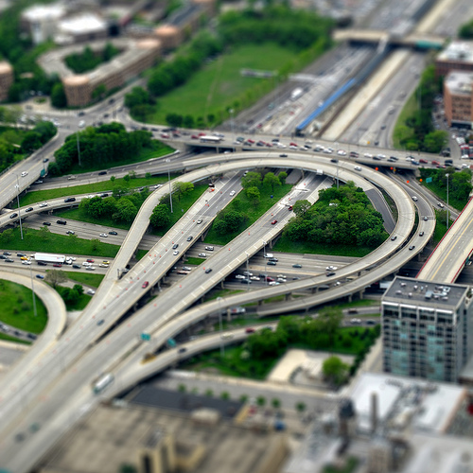
Poor Data Management Federal Agency Example
In preparation for a Resource Management Plan, an office discovered 14 duplicate GPS inventories of roads. However, because none of the inventories had enough metadata, it was impossible to know which inventory was best or if any of the inventories actually met their requirements.
Solution: Re-Inventory roads
Cost: Estimated 9 work months/inventory
@$4,000/work month
(14 inventories = $504,000)
CC image by ruffin_ready on Flickr
Notes:
In this example, time (and money) could have been saved if each GPS inventory had sufficient metadata to enable appropriate re-use.

Slide 13
Value of Data Management: Importance for researchers and science

Slide 14
Importance of Data Management
“Please forgive my paranoia about protocols, standards, and data review. I'm in the latter stages of a long career with USGS (30 years, and counting), and have experienced much. Experience is the knowledge you get just after you needed it.
Several times, I've seen colleagues called to court in order to testify about conditions they have observed.
Without a strong tradition of constant review and approval of basic data, they would've been in deep trouble under cross-examination. Instead, they were able to produce field notes, data approval records, and the like, to back up their testimony.
It's one thing to be questioned by a college student who is working on a project for school. It's another entirely to be grilled by an attorney under oath with the media present.”
- Nelson Williams, Scientist US Geological Survey
Notes:
Good data management supports transparency and reproducibility of results. In this example, good data management (the field notes, data approval records, etc.) helped to support court testimony.

Slide 15
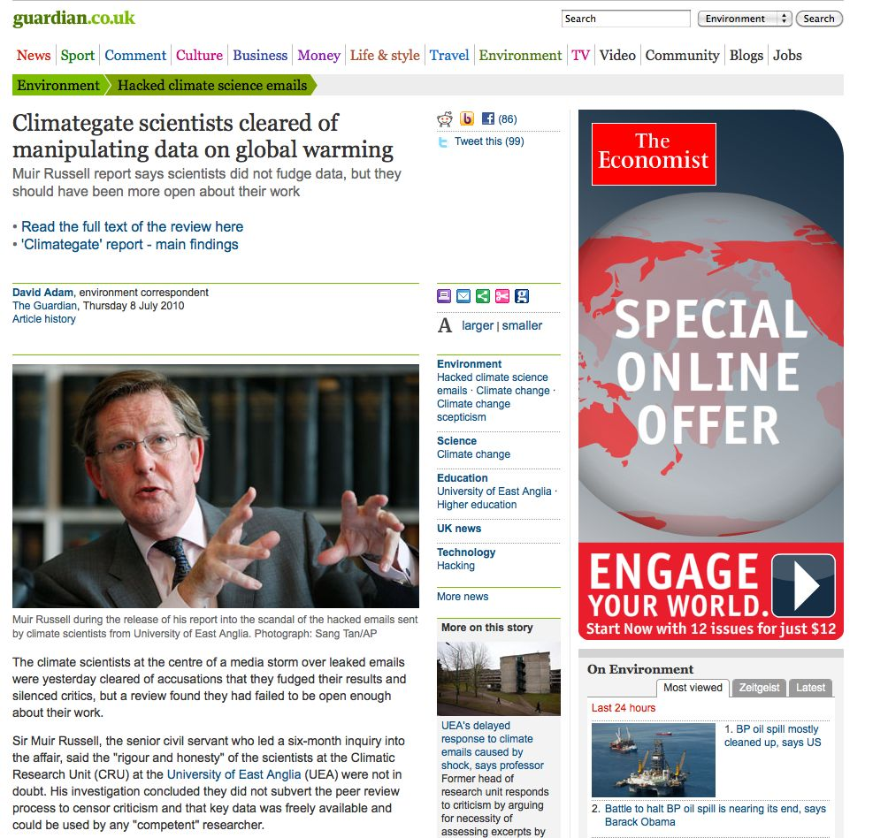
Importance of Data Management
The climate scientists at the centre of a media storm over leaked emails were yesterday cleared of accusations that they fudged their results and silenced critics, but a review found they had failed to be open enough about their work.
Notes:
Open science, transparency, and reproducibility of results are becoming increasingly important outside of academia, as the media and public have interest in how public research dollars are spent, and how scientific conclusions/evidence affect the real world.

Slide 16
Why Manage Data: Researcher Perspective
Manage your data for yourself:
Keep yourself organized – be able to find your files (data inputs, analytic scripts, outputs at various stages of the analytic process, etc.)
Track your science processes for reproducibility – be able to match up your outputs with exact inputs and transformations that produced them
Better control versions of data – easily identify versions that can be periodically purged
Quality control your data more efficiently
Notes:
Aside from reproducibility and transparency (though both excellent reasons!), good data management provides many benefits to the researcher.

Slide 17
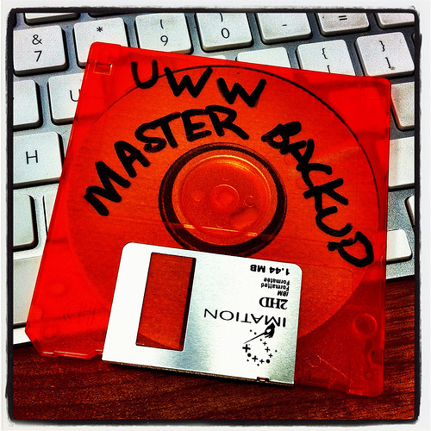
Why Data Management: Researcher Perspective
To avoid data loss (e.g. making backups)
Format your data for re-use (by yourself or others)
Be prepared: Document your data for your own recollection, accountability, and re-use (by yourself or others)
Gain credibility and recognition for your science efforts through data sharing!
CC image by UWW ResNet on Flickr
Notes:
Aside from reproducibility and transparency (though both excellent reasons!), good data management provides many benefits to the researcher.

Slide 18
Why Data Management: Foundation to Advance Science
Data is a valuable asset – it is expensive and time consuming to collect
Data should be managed to:
maximize the effective use and value of data and information assets
continually improve the quality including: data accuracy, integrity, integration, timeliness of data capture and presentation, relevance, and usefulness
ensure appropriate use of data and information
facilitate data sharing
ensure sustainability and accessibility in long term for re-use in science
Notes:
Data management and sharing help advance science through re-use…

Slide 19
Data Management Facilitates Sharing and
Re-use…
Notes:
Data management and organization facilitate archiving, sharing, and publishing of data. These activities feed data re-use and reproducibility in science.

Slide 20
Where a majority of data end up now…
Notes:
There is an abundance of data and metadata (if it is done) that end up in filing cabinets, on discarded hard drives, in hard-copy journals on the library shelves (or on the web), but many are subscription-only journals.

Slide 21
Imagine if data were more accessible….
Notes:
Data should be properly managed and eventually be placed where they are accessible, understandable, and re-usable.

Slide 22
Well managed, publically accessible data is important: why?
Here are a few reasons (from the UK Data Archive):
Increases the impact and visibility of research
Promotes innovation and potential new data uses
Leads to new collaborations between data users and creators
Maximizes transparency and accountability
Enables scrutiny of research findings
Encourages improvement and validation of research methods
Reduces cost of duplicating data collection
Provides important resources for education and training
Notes:
UK Data Archive: http://www.data-archive.ac.uk/

Slide 23

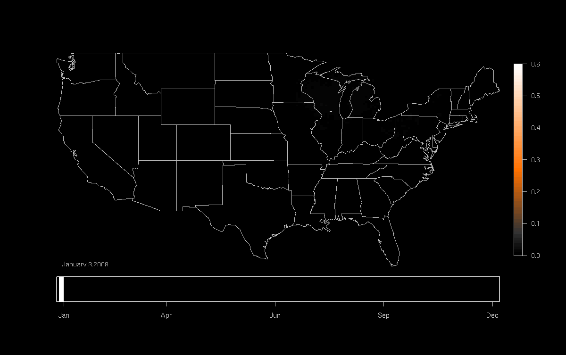

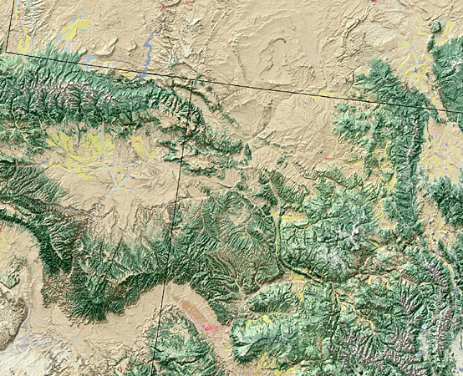
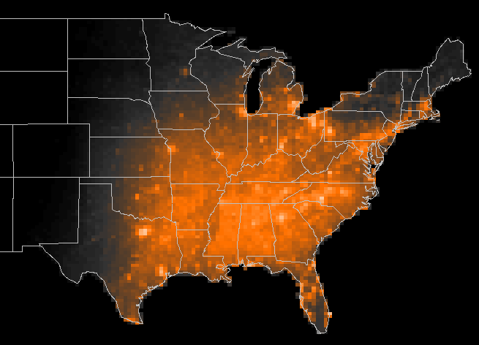


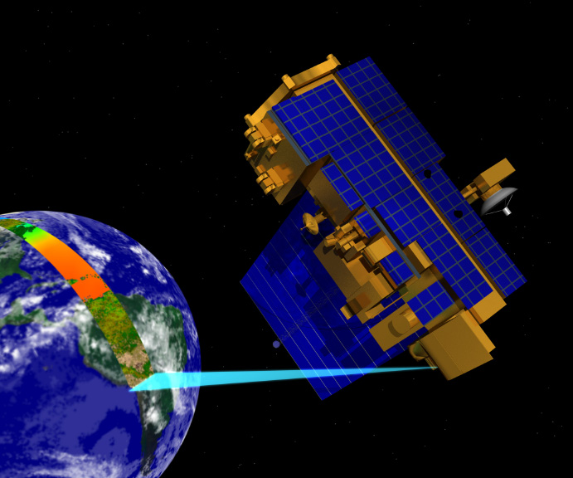
Well-Managed Data Can Result in Re-use, Integration, and New Science
Model results
eBird
Occurrence of Indigo Bunting (2008)
Land Cover
Jan
Apr
Jun
Sep
Dec
Meteorology
Potential Uses-
Examine patterns of migration
Infer impacts of climate change
Measure patterns of habitat usage
Measure population trends
Spatio-Temporal Exploratory Models predict the probability of occurrence of bird species across the United States at a 35 km x 35 km grid.
MODIS – Remote sensing data
Slide courtesy of DataOne
Notes:
By re-using data collected from a variety of sources – eBird database, land cover data, meteorology, and remotely sensed by NASA – this project was able to compile and process the data using supercomputering to determine bird migration routes for particular species.

Slide 24
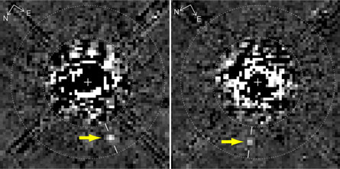
“Planet hidden in Hubble archives” Science News (Feb. 27, 2009)
New Discoveries
A new image processing technique reveals something not before seen in this Hubble Space Telescope image taken 11 years ago: A faint planet (arrows), the outermost of three discovered with ground-based telescopes last year around the young star HR 8799.D. Lafrenière et al., Astrophysical Journal Letters.
D. Lafrenière et al., ApJ Letters
“The first thing it tells you is how valuable maintaining long-term archives can be. Here is a major discovery that’s been lurking in the data for about 10 years!” comments Matt Mountain, director of the Space Telescope Science Institute in Baltimore, which operates Hubble.
“The second thing its tells you is having a well calibrated archive is necessary but not sufficient to make breakthroughs — it also takes a very innovative group of people to develop very smart extraction routines that can get rid of all the artifacts to reveal the planet hidden under all that telescope and detector structure.”
Notes:
Research data has unknown potential future value. New technology and analysis methods may be used to re-analyze data, leading (potentially) to new discoveries.
Source: https://www.sciencenews.org/article/planet-hidden-hubble-archives

Slide 25
What is the Data Life Cycle?
Assure
Preserve
Discover
Integrate
Analyze
Plan
Describe
Collect
Notes:
A data lifecycle illustrates stages through which well-managed data passes from the inception of a research project to its conclusion. In the reality of science research, the stages do not always follow a continuous circle.

Slide 26
For Each Stage of the Data Lifecycle…
…there are best practices… and… tools to help!
The following data management lessons will illustrate in detail each stage of the data lifecycle
Your well-managed and accessible data can contribute to science in ways you may not even imagine today!
Notes:
The rest of the DataONE Education Modules, handouts, and hands-on exercises are available at: https://www.dataone.org/education-modules

Slide 27
Summary
If data are:
Well-organized
Documented
Preserved
Accessible
Verified as to accuracy and validity
Result is:
High quality data
Easy to share and re-use in science
Citation and credibility to the researcher
Cost-savings to science

Slide 28
Summary, con’t
The data deluge has created a surge of information that needs to be well-managed and made accessible.
The cost of not doing data management can be very high.
Be cognizant of best practices and tools associated with the data lifecycle to manage your data well.
Many benefits are associated with the act of managing data, including the ability to find, access, understand, integrate, and re-use data.

Slide 29
Resources
Chatfield, T., Selbach, R. February 2011. Data Management Training Workshop. Bureau of Land Management (BLM).
Strasser, Carly. February 2012. Data Management for Scientists. http://www.slideshare.net/carlystrasser/oceansciences2012workshop
UK Data Archive. May 2011. Managing and Sharing Data: Best Practices for Researchers. http://www.data-archive.ac.uk/media/2894/managingsharing.pdf
DAMA International, The DAMA Guide to the Data Management Body of Knowledge. https://www.dama.org/content/body-knowledge

Slide 30

The full slide deck may be downloaded from:
http://www.dataone.org/education-modules
Suggested citation:
DataONE Education Module: Data Management. DataONE. Retrieved Nov 16, 2016. From http://www.dataone.org/sites/all/documents/L01_DataManagement.pptx
Copyright license information:
No rights reserved; you may enhance and reuse for your own purposes. We do ask that you provide appropriate citation and attribution to DataONE.

